Slide 1
Machine Learning-Based Analysis of Cells and Tissues following Joint Injury
Spencer P. Lake
Associate Professor
Mechanical Engineering & Materials Science
GRC – Musculoskeletal Biology and Engineering
8.8.24

Slide 2
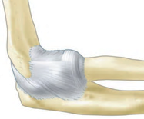
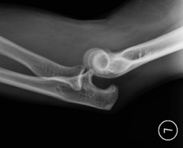
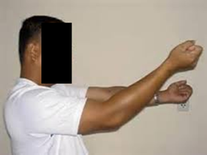
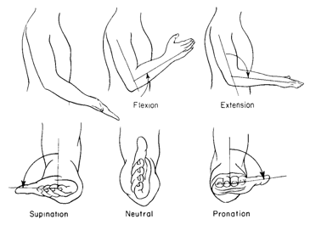

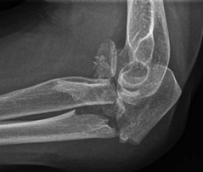
Post-traumatic Elbow Contracture
Normal Anatomy
and Function
Traumatic Injury
Post-traumatic
Joint Contracture
Most commonly dislocated joint in children; #2 in adults²
Humerus
Range-of-motion¹
F-E: 130-140° (100°)
P-S: 180° (100°)
Radius
Ulna
ten Brinke+ 2016
Simple dislocation
Pischke 2014
Robinson+ 2017
Loss of joint motion and permanent stiffness³
Often 35-55° F-E reduction⁴
Affects up to 12% of patients following elbow injury⁵
Debilitating condition
Flexion
Extension
Supination
Neutral
Pronation
Complex fracture
Chao 1978
Mader+ 2014
¹Morrey+ JBJS 1981; ²Kuhn+ OCNA 2008; ³Anakwe+ JBJS 2011; ⁴Bryce+ OCNA 2008; ⁵Myden+ JSES 2011

Slide 3
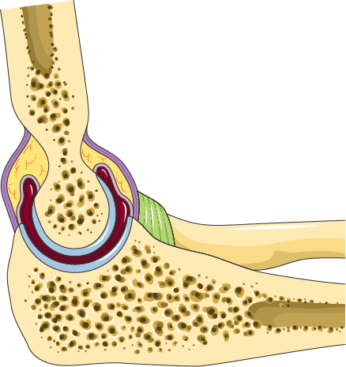
Elbow PTJC
Fat
Bone
Capsule
Cartilage
Ligaments
Elbow PTJC is difficult to treat for several reasons:
Multiple tissues are often damaged in a traumatic injury: capsule, ligaments, cartilage, and/or bone
Multiple mechanisms are involved in contracture formation/persistence
Elbow PTJC is unpredictable: initial injury severity does not necessarily correlate with functional deficits
Elbow - Lateral view - Servier Medical Art

Slide 4
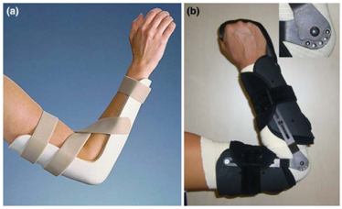
Treatment of Elbow PTJC
Conservative treatment
Physical therapy, splinting, manipulation
Helpful but often not successful
Surgical Treatment
12-15% of patients require surgical release of capsule¹
Usually improves joint function
However, only ~50% of motion regained²⁻³
Other options are debilitating
Total elbow arthroplasty and joint fusion
Prevention and treatment strategies are desperately needed
Marinelli et al 2010
Mansat and Morrey 2015
1. Myden 2011. 2. Higgs+ JBJS 2012. 3. Hildebrand+ JHSA 2013.

Slide 5
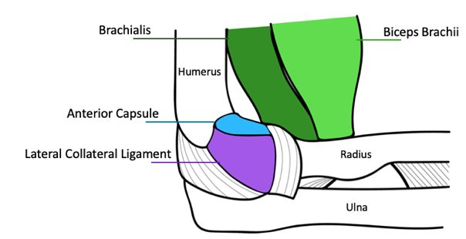
Post-Traumatic Joint Contracture
Objectives:
Determine etiology and progression of the fibrotic response
Identify tissues that contribute to motion loss
Develop treatment strategies to reduce or prevent functional impact of PTJC
Leverage results from preclinical studies to inform clinical approaches to PTJC

Slide 6

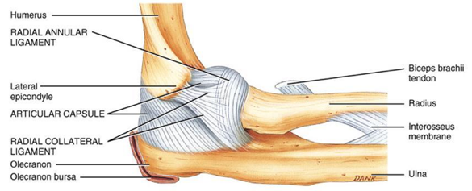
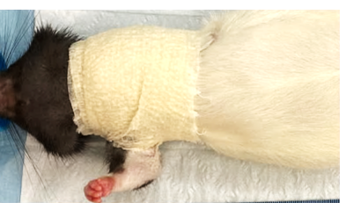
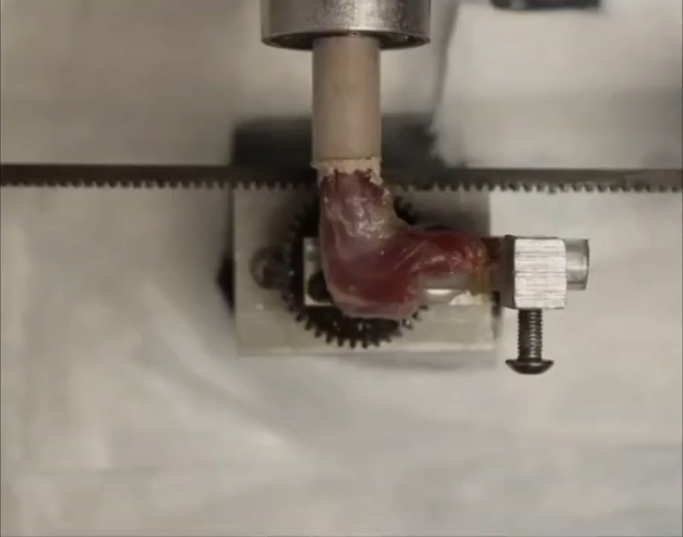
Preclinical Model of PTJC
Developed the first animal model of persistent post-traumatic elbow contracture which mimics the human condition
(Lake+ JOR 2016, Dunham+ JSES 2017, Dunham+ JBME 2017)
Identified the soft tissues which contribute to persistent elbow contracture
(Dunham+ JBJS 2019)
Long-Evans Rat
Simulate dislocation injury
Immobilization
Humerus
Total ROM
* = different from control
Ulna/
Radius
Elbow
¹Lake+ JOR 2016; ²Dunham+ JSES 2017; ³Dunham+ COOR 2018; ⁴Dunham+ JBJS 2019

Slide 7
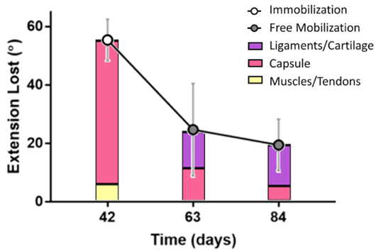
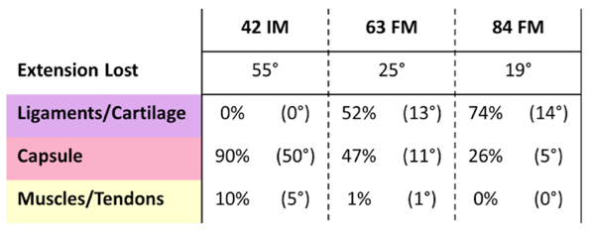
Preclinical Model of PTJC
Developed the first animal model of persistent post-traumatic elbow contracture which mimics the human condition
(Lake+ JOR 2016, Dunham+ JSES 2017, Dunham+ JBME 2017)
Identified the soft tissues which contribute to persistent elbow contracture
(Dunham+ JBJS 2019)
¹Lake+ JOR 2016; ²Dunham+ JSES 2017; ³Dunham+ COOR 2018; ⁴Dunham+ JBJS 2019

Slide 8
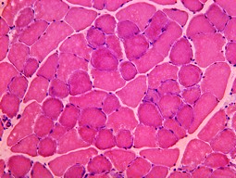
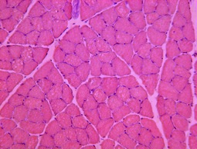
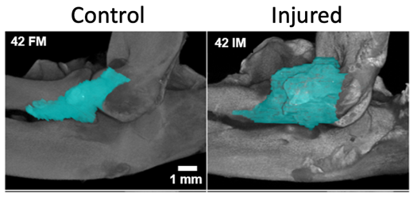
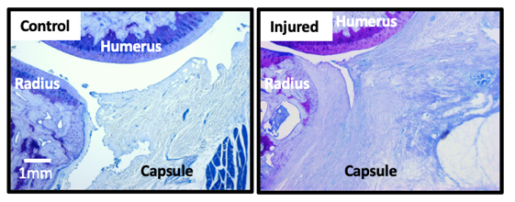
Preclinical Model of PTJC
Developed the first animal model of persistent post-traumatic elbow contracture which mimics the human condition
(Lake+ JOR 2016, Dunham+ JSES 2017, Dunham+ JBME 2017)
Identified the soft tissues which persistently contribute to elbow contracture
(Dunham+ JBJS 2019)
Confirmed that muscle is not a permanent contributor to persistent elbow joint contracture
(Dunham+ Muscle Nerve 2018)
Identified that anterior capsule fibrosis and lateral collateral ligament hypertrophy contribute to mechanical joint deficiency
(Dunham+ CORR 2018, Dunham+ JOR 2021)
Control
Injured
200 µm

Slide 9
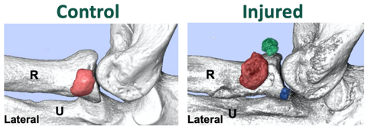
Preclinical Model of PTJC
Developed the first animal model of persistent post-traumatic elbow contracture which mimics the human condition
(Lake+ JOR 2016, Dunham+ JSES 2017, Dunham+ JBME 2017)
Identified the soft tissues which contribute to persistent elbow contracture
(Dunham+ JBJS 2019)
Confirmed with physiological testing that muscle is not a permanent contributor to elbow contracture
(Dunham+ Muscle Nerve 2018)
Identified that anterior capsule fibrosis and lateral collateral ligament hypertrophy contribute to mechanical joint deficiency
(Dunham+ CORR 2018, Dunham+ JOR 2021)
Observed changes in ectopic calcification within soft tissues that may be contributing to stiffness and motion loss (Reiter+ JOR 2021)

Slide 10
Preclinical Model of PTJC
Developed the first animal model of persistent post-traumatic elbow contracture which mimics the human condition
(Lake+ JOR 2016, Dunham+ JSES 2017, Dunham+ JBME 2017)
Identified the soft tissues which contribute to persistent elbow contracture
(Dunham+ JBJS 2019)
Confirmed with physiological testing that muscle is not a permanent contributor to elbow contracture
(Dunham+ Muscle Nerve 2018)
Identified that anterior capsule fibrosis and lateral collateral ligament hypertrophy contribute to mechanical joint deficiency
(Dunham+ CORR 2018, Dunham+ JOR 2021)
Observed changes in ectopic calcification within soft tissues that may be contributing to stiffness and motion loss (Reiter+ JOR 2021)
However, much remains unknown regarding cellular response and tissue changes following injury
How do we assess success of treatments?
Validated animal model -> can now evaluate treatment for PTJC
Physical (PT), biological (drugs, stem cells) and combined treatments

Slide 11
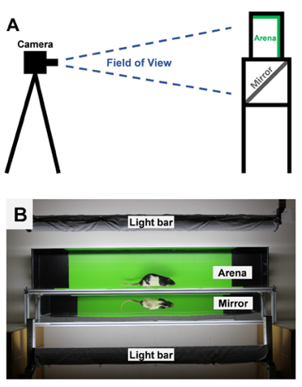
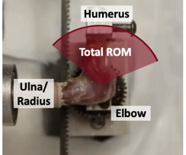
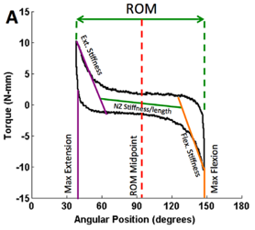
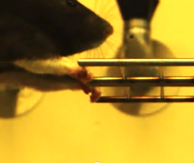
Treatment Success? Mechanics and function
Joint Mechanics
Gait Analysis
Forelimb Strength
Kyle Allen, U of Florida
Lake+ JOR 2016; Dunham+ JBJS 2019; Jacobs+ Sci Rep 2018; Reiter+ JBME 2019; Reiter+ JOR 2021

Slide 12
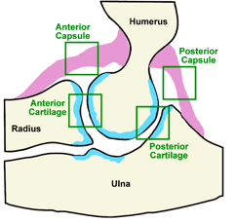
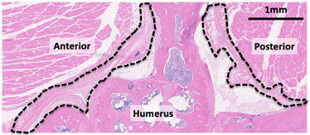
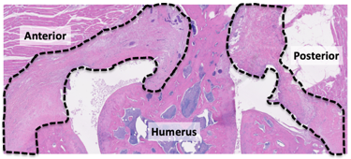
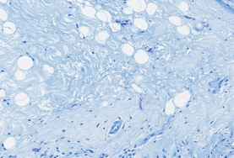
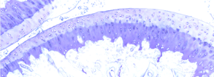
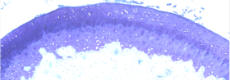
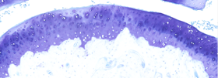
Treatment Success? Tissue and cell changes
Control
IM21
Many spatially varying features!
Need enhanced image-based analyses to extract meaningful information…
Many spatially varying features!
Need enhanced image-based analyses to extract meaningful information… MACHINE LEARNING!
No Drug
Drug A
Drug B
Capsule
Cartilage
David+ Frontiers Bioeng Biotech 2022; Reiter+ JBJS 2023

Slide 13
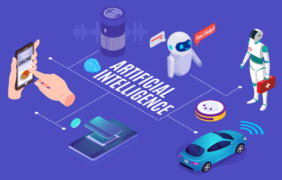

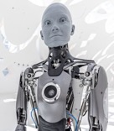
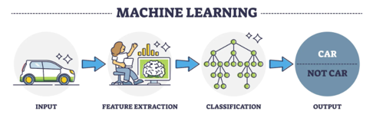
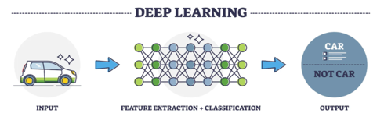
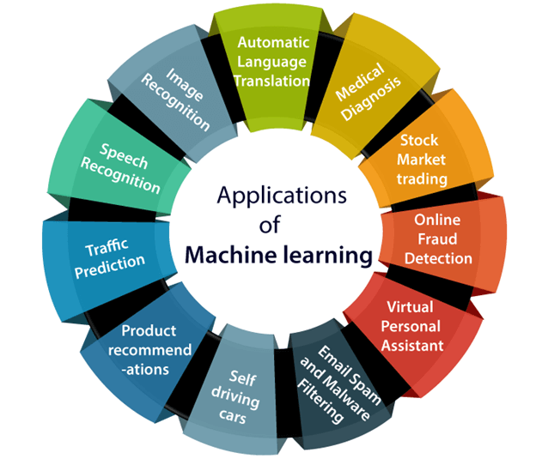
Basics of Machine Learning
Applications of AI
Artificial Intelligence (AI)
Machines are taught or trained to perform tasks normally requiring intelligence
Machine Learning (ML)
Algorithms learn from patterns of data to predict, classify, and cluster without being explicitly programmed
Applications of ML
Deep Learning (DL)
Uses artificial neural networks (which function like the human brain) to perform tasks
https://revolveai.com/examples-of-artificial-intelligence/
https://www.javatpoint.com/applications-of-machine-learning
https://www.turing.com/kb/ultimate-battle-between-deep-learning-and-machine-learning
https://www.cnn.com/2022/12/28/world/sophia-desdemona-robot-sisters-ai-spc-intl/index.html
Notes:
In 1950, the inventor of this term, Arthur Samual, said, Machine learning is the science of getting computers to act without being explicitly programmed.

Slide 14


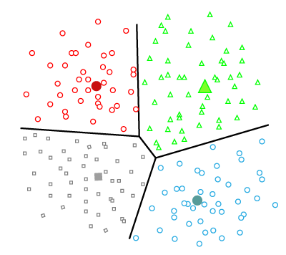
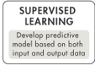
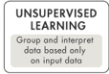
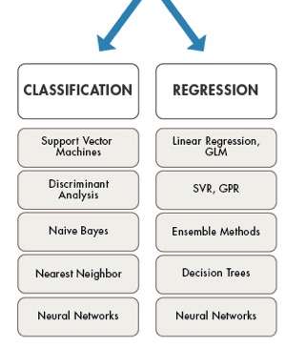
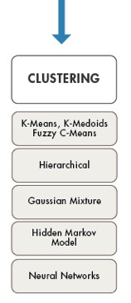
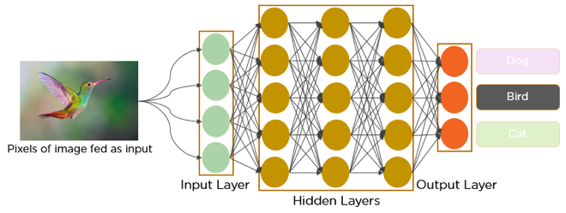
Basics of Machine Learning
Classification
Regression
Clustering
Goal: use ML-based tools to study spatial changes in tissues and cells in our model of PTJC
Deep Learning using Neural Networks E.g., image analysis using convolutional neural networks (CNNs)
https://www.mathworks.com/help/stats/machine-learning-in-matlab.html; https://www.javatpoint.com/regression-vs-classification-in-machine-learning
https://www.javatpoint.com/clustering-in-machine-learning; https://www.analyticsvidhya.com/blog/2021/05/convolutional-neural-networks-cnn/
Notes:
SVR (support vector machine regression); GPR (Gaussian process regression); GLM (generalized linear models);
Not talking about reinforcement learning (the third other type of machine learning)
https://www.mathworks.com/help/stats/machine-learning-in-matlab.html
https://www.javatpoint.com/regression-vs-classification-in-machine-learning
https://www.javatpoint.com/clustering-in-machine-learning
https://www.analyticsvidhya.com/blog/2021/05/convolutional-neural-networks-cnn/

Slide 15
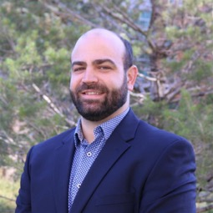
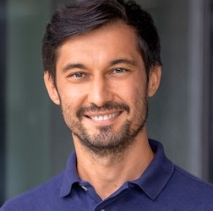

A few notes…
Not a full review of the field or overview of all available techniques…
…but a story of how one lab is using ML tools to address a scientific question
Special thanks to Mike and Bek
Most examples are preliminary and/or exploratory (all unpublished)
Very much a work-in-progress where we are still learning a lot as go along
I would love to hear feedback and suggestions!
Michael David, Ph.D
U of Colorado Boulder
Ulugbek Kamilov, Ph.D
Wash U (Comp. Sci.)

Slide 16
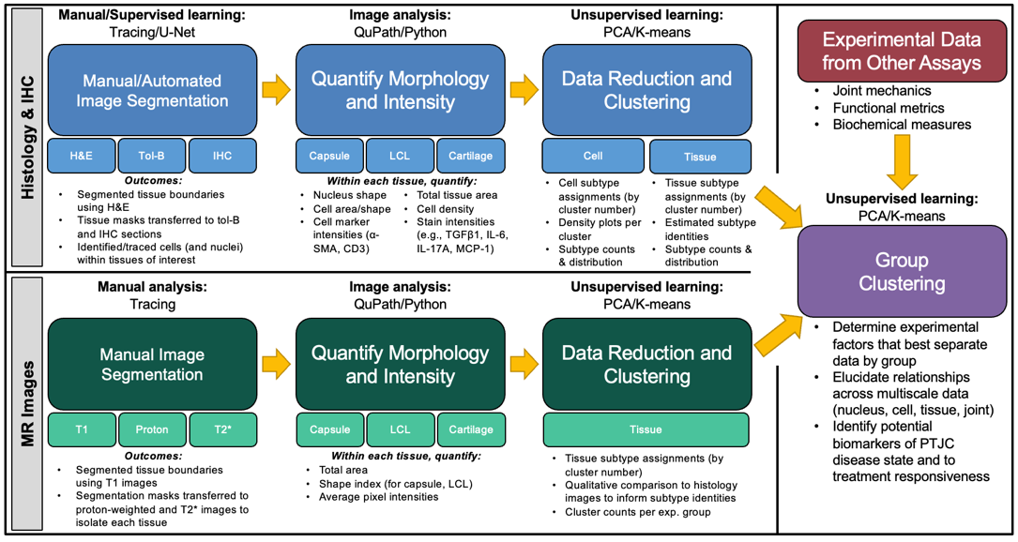
Overall Approach Using ML
Notes:
Overall plan. Have good progress on some of these tasks…just starting on others…and some we haven’t begun at all.

Slide 17
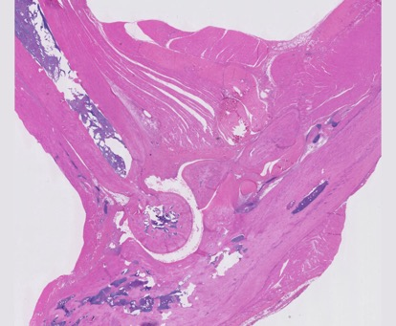
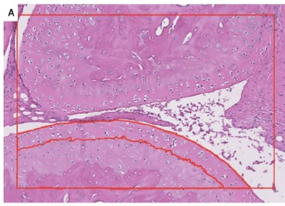
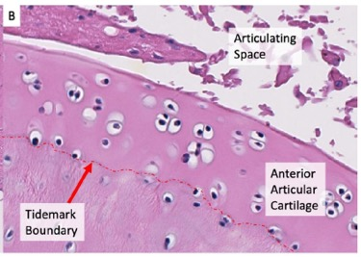
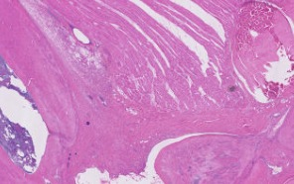
Image Segmentation
Segmentation of Capsule, Cartilage, & Cells
Humerus
Cartilage
Radius
Approach
Digital scans of H&E sections (n=37) at 20x (460nm/pixel)
Groups: control, injury (+ varying immobilization), injury (+ treatments)
Manual tracing using QuPath
Segmentation using U-Net (CNN)
Capsule (from all other tissues in image) and cells
Cartilage
Articular and calcified cartilage
Chondrocytes within articular cartilage
Model success determined via Dice coefficient
Ulna
Capsule

Slide 18
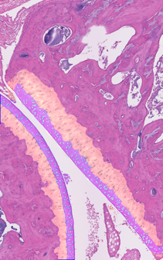



Image Segmentation
Segmentation of Cartilage & Chondrocytes
Articular Cartilage
Calcified Cartilage
Chondrocytes
Radius
Humerus
Target | Dice Coefficient
Articular Cartilage | 0.97
Calcified Cartilage | 0.94
Articular Cartilage Chondrocytes | 0.81

Slide 19
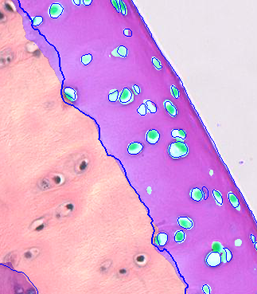
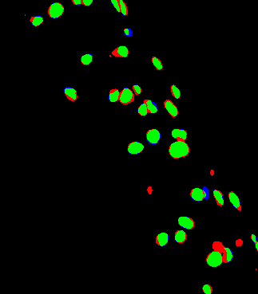
Image Segmentation
Chondrocyte Segmentation – Close Pairs
True Positive
False Positive
False Negative

Slide 20




Morphology & Intensity
Tissue/Cell Quantification
H&E
Tissue Level
Tissue thickness/area
Staining intensities
General stains (H&E, tol blue)
Specific targets via immunohistochemistry
Cellular Level
Morphology
Cell number, perimeter, area, circularity, eccentricity
Nuclear area, circularity, eccentricity
Spatial analysis
Density, number of neighbors, median distance
Staining intensities
Cell marker via immunohistochemistry
Capsule
Tol Blue
Cartilage

Slide 21







Morphology & Intensity
Capsule Cells Nuclear Morphology and Connectivity
Nucleus Area
Nucleus Circularity
17.15 ± 8.85
0.74 ± 0.16
Connectivity
# of Neighbors
Median Distance
5.97 ± 1.43
27.44 ± 28.34

Slide 22




Data Reduction & Clustering
Cell-based Analysis of Capsule
K-means clustering using combined set of cell-based parameters
Density map of one cluster type
Color = cluster #
Capsule
100 μm
Notes:
H&E staining intensity and nuclear morphology
Cartilage done separately from capsule

Slide 23





Data Reduction & Clustering
Group Clustering
Prediction and Clustering
Histology Scores
Joint Mechanics
Study Groups
Group | Days Post-Injury
Control | 42 & 84
Injured + No Treatment | 42 & 84
Injured + Physical Therapy | 42 & 84
Injured + Drugs | 84
Capsule
100µm
Cartilage
100µm
Approach
Histological images (n=67 rat elbows) with matched joint mechanics
Study groups: control, injury (varying immobilization), injury (plus treatments)
Objectives
Predict joint range of motion (supervised learning)
Predict study group (supervised learning)
Data exploration and clustering (unsupervised learning)

Slide 24
Data Reduction & Clustering
Group Clustering
Predict Joint Range of Motion Based on Histology Metrics
Input
Output
Objective:
Predict joint range of motion from capsule histology scores (supervised learning)
Capsule or Cartilage Histology Scores
Joint Range of Motion
Input | Output | Decision Tree (R²) | Bagging (R²) | Support Vector (R²) | Random Forest (R²) | K-Nearest Neighbor (R²)
Anterior Capsule | ROM | -0.08 | 0.04 | 0.24 | 0.38 | 0.23
Posterior Capsule | ROM | -0.3 | 0.50 | 0.37 | 0.42 | 0.32
Anterior Cartilage | ROM | 0.09 | 0.04 | 0.22 | 0.10 | 0.23
Posterior Cartilage | ROM | -0.75 | -0.70 | -0.07 | -0.60 | -0.42
Problem type:
Regression
Notes:
These are test scores; negative R-squared values indicate poor fits, perhaps overfitting.

Slide 25


Data Reduction & Clustering
Group Clustering
Predict Study Groups with Histology Scores and Biomechanics
Input
Output
Objective:
Predict study group from histology scores and biomechanics (supervised learning)
Capsule or Cartilage Histology Scores &
Elbow Biomechanics
Study Group
Capsule ROC Curve
Input | Multinominal Logistic Regression (F1/AUC) | Support Vector Classification (F1/AUC) | K-Nearest Neighbor Classification (F1/AUC)
Ant Cap + Biomech | 0.47/0.91 | 0.34/0.74 | 0.34/0.82
Post Cap + Biomech | 0.62/0.94 | 0.34/0.83 | 0.59/0.83
Ant Cart + Biomech | 0.41/0.86 | 0.20/0.50 | 0.33/0.74
Post Cart + Biomech | 0.51/0.87 | 0.46/0.78 | 0.36/0.74
Problem type:
Better Predictions
Classification
Worse Predictions
True Positive Rate
False Positive Rate
Notes:
ROC (receiver operating characteristic curve) = shows performance of a classifier algorithm
https://en.wikipedia.org/wiki/F-score
F1 is related to false positives; higher F1 is good (1 is goal)
SHAP -> (not used here) help interpret what is giving the classification accuracy
Having a high AUC (Area Under the Curve) but a low F1 score indicates that the model has good overall ranking ability, but struggles with accurately classifying instances, particularly when balancing precision and recall.
The AUC measures the overall ranking performance of a binary classifier by plotting the true positive rate against the false positive rate across all possible classification thresholds. A high AUC suggests the model can generally separate positive and negative instances well, even if the actual classification decisions are not optimal.
In contrast, the F1 score is the harmonic mean of precision and recall. A low F1 score means the model is not adept at making accurate classification decisions that balance minimizing false positives (high precision) and false negatives (high recall).
This scenario can occur when the model has good discriminative power to rank instances, but the chosen decision threshold is not well-calibrated to the task at hand. The model may excel at identifying the most clear-cut positive and negative cases, but struggle with the more ambiguous instances near the decision boundary. Adjusting the decision threshold or using techniques like class weighting may help improve the F1 score in this situation.

Slide 26




Data Reduction & Clustering
Group Clustering
Capsule Histology Scores and Biomechanics Reveal Distinct Clusters of Study Groups
Capsule Histology Scores &
Elbow Biomechanics
Objective:
Explore/cluster capsule histology scores and biomechanics (unsupervised)
Input:
PC1 PC2 PC3
'0-Drug': 0,
'0-None’: 1,
'14-None': 2,
'14-PT': 3,
'21-None': 4,
'21-PT': 5,
'3-None': 6,
'42-Drug': 7,
'42-None': 8,
'7-None': 9
Problem type:
Histology
Clustering
Cluster2
Biomechanics
Cluster 1: Controls (uninjured)
Cluster 2: Injury @ early timepts (w/ or w/o PT)
Cluster 3: Injury @ late timepts (w/ or w/o drugs)
Notes:
K-means for the clustering step; unsupervised machine learning
Clustering is used to find phenotypes; type of data integration -> combining two different types of data

Slide 27





Summary of Histology-based ML
Summary
Established a machine learning pipeline for PTJC
Obtained encouraging tissue (i.e., capsule, cartilage) and cell segmentation (supervised learning)
Observed prediction (supervised learning) and unique separation (unsupervised learning) of study groups
Input Image
Traced Mask
Predicted Mask
Considerations/Future work
Generalizability (i.e., scalability)
Identifying best algorithms for each task
Extracting meaning from completed analyses
Incorporate other (new) data to clustering and prediction tasks

Slide 28
Overall Approach Using ML

Slide 29

Image Segmentation
Morphology & Intensity
Data Reduction and Clustering
Overview of MRI-Based Approach
Capsule Segmentation
Sub-Tissue Clustering
Disease Prediction
LoRes
Image Patch Extraction
Capsule
Sub-tissue Clustering
Classification Model
U-Net
HiRes
Tissue Centroids
MR Images
Fixed elbows (n=24) soaked in gadolinium contrast agent
T1-weighted images acquired using 11.74 T scanner (voxel size=31.3μm; ~150 images per elbow)
Images exported as 2D slices, color normalized, up-sampled, and analyzed in Python
Capsule with Sub-tissue Clusters
Image Statistics
Image Patches
25x25 pixels
Capsule Statistics
Classific-ation Model
Disease State Prediction
Normalized Clustering Counts
K-nearest neighbors (KNN)
K-Means
Clustering

Slide 30







Image Segmentation
Morphology & Intensity
Data Reduction and Clustering
MRI-based Results
Capsule Segmentation
Tissue Clustering
Disease Prediction
10 clusters
35 clusters
Figure 3. (A) The fully constructed pipeline with ML capsule segmentation, capsule tissue clustering, and disease severity prediction. (B) Table showing the breakdown of sample #s.

Slide 31


Morphology & Intensity
Alternative Sub-tissue Identification
Limitations of sub-tissue clustering approach
Computationally intensive and slow
Biological meaning of 25-30 cluster types?
STEGO^{1,2}
“Self-supervised Transformer with Energy-based Graph Optimization”
Discovers meaningful categories without need for any form of annotation (unsupervised)
STEGO identifies relationships between objects and encourages regions with similar features to share the same class label
More computationally efficient
Input: MR images with segmented capsules
STEGO OVERVIEW (from Github²)
¹Hamilton et al ICLR 2022. ²https://github.com/mhamilton723/STEGO

Slide 32







Morphology & Intensity
STEGO for Capsule Analysis
Healthy
Radar Plot of Class Features
Clustering w/ Class Features
Injured
Results/Comments
Specified number of sub-tissues classes (n=4)
Qualitative differences between healthy and injured
Sub-tissue classification yields several parameters that can be used for clustering by study group
Validation and biological interpretation of class labels?

Slide 33







Summary of MRI-based ML
Summary
Established a ML pipeline for evaluation of MRI in PTJC
Successfully segmented capsule tissue
Employed two unbiased approaches to determine sub-tissues within the capsule
Preliminary results in classifying disease severity
Ongoing/Future Work
Optimize models with more data and explore different frameworks to enhance the performance of the pipeline
Biological interpretation of sub-tissues
Use models to examine other tissues in elbow PTJC (e.g., ligaments, cartilage)
Combine outcomes for histology with MR and with other metrics of our animal model
Healthy
Contracted

Slide 34
Overall Approach Using ML

Slide 35





Acknowledgements
Lab Members
Funding
Ryan Castile
Shawn Pavey
Becky Reals
Alexander Gadin
Genevieve Jarrell
Nathan DeSpain
Sophia Miller
Haruna Takahashi
Former members:
Mike David, Ph.D.
Chelsey Dunham, Ph.D.
Alex Reiter, Ph.D.
Shikha Shah
Arun Movva
Evan Bradley
Gustavo De Paiva
NIH R03 AR067504
NIH R01 AR071444
NIH P30 AR074992
NIH T32 EB018266
NIH T32 AR060719
NSF DGE 1745038
Olin Fellowship
ASES Grant
WU CRM Seed Grant
Collaborators
Aaron Chamberlain, M.D.
Paul Cannon, M.S.
Bek Kamilov, Ph.D.
Benjamin Zmistowski, M.D.
Necat Havlioglu, M.D.
Matt Bersi, Ph.D.
Gretchen Meyer, Ph.D.
Leesa Galatz, M.D.
Kyle Allen, Ph.D.
Juergen Brinckmann, Ph.D.

